Slide 1
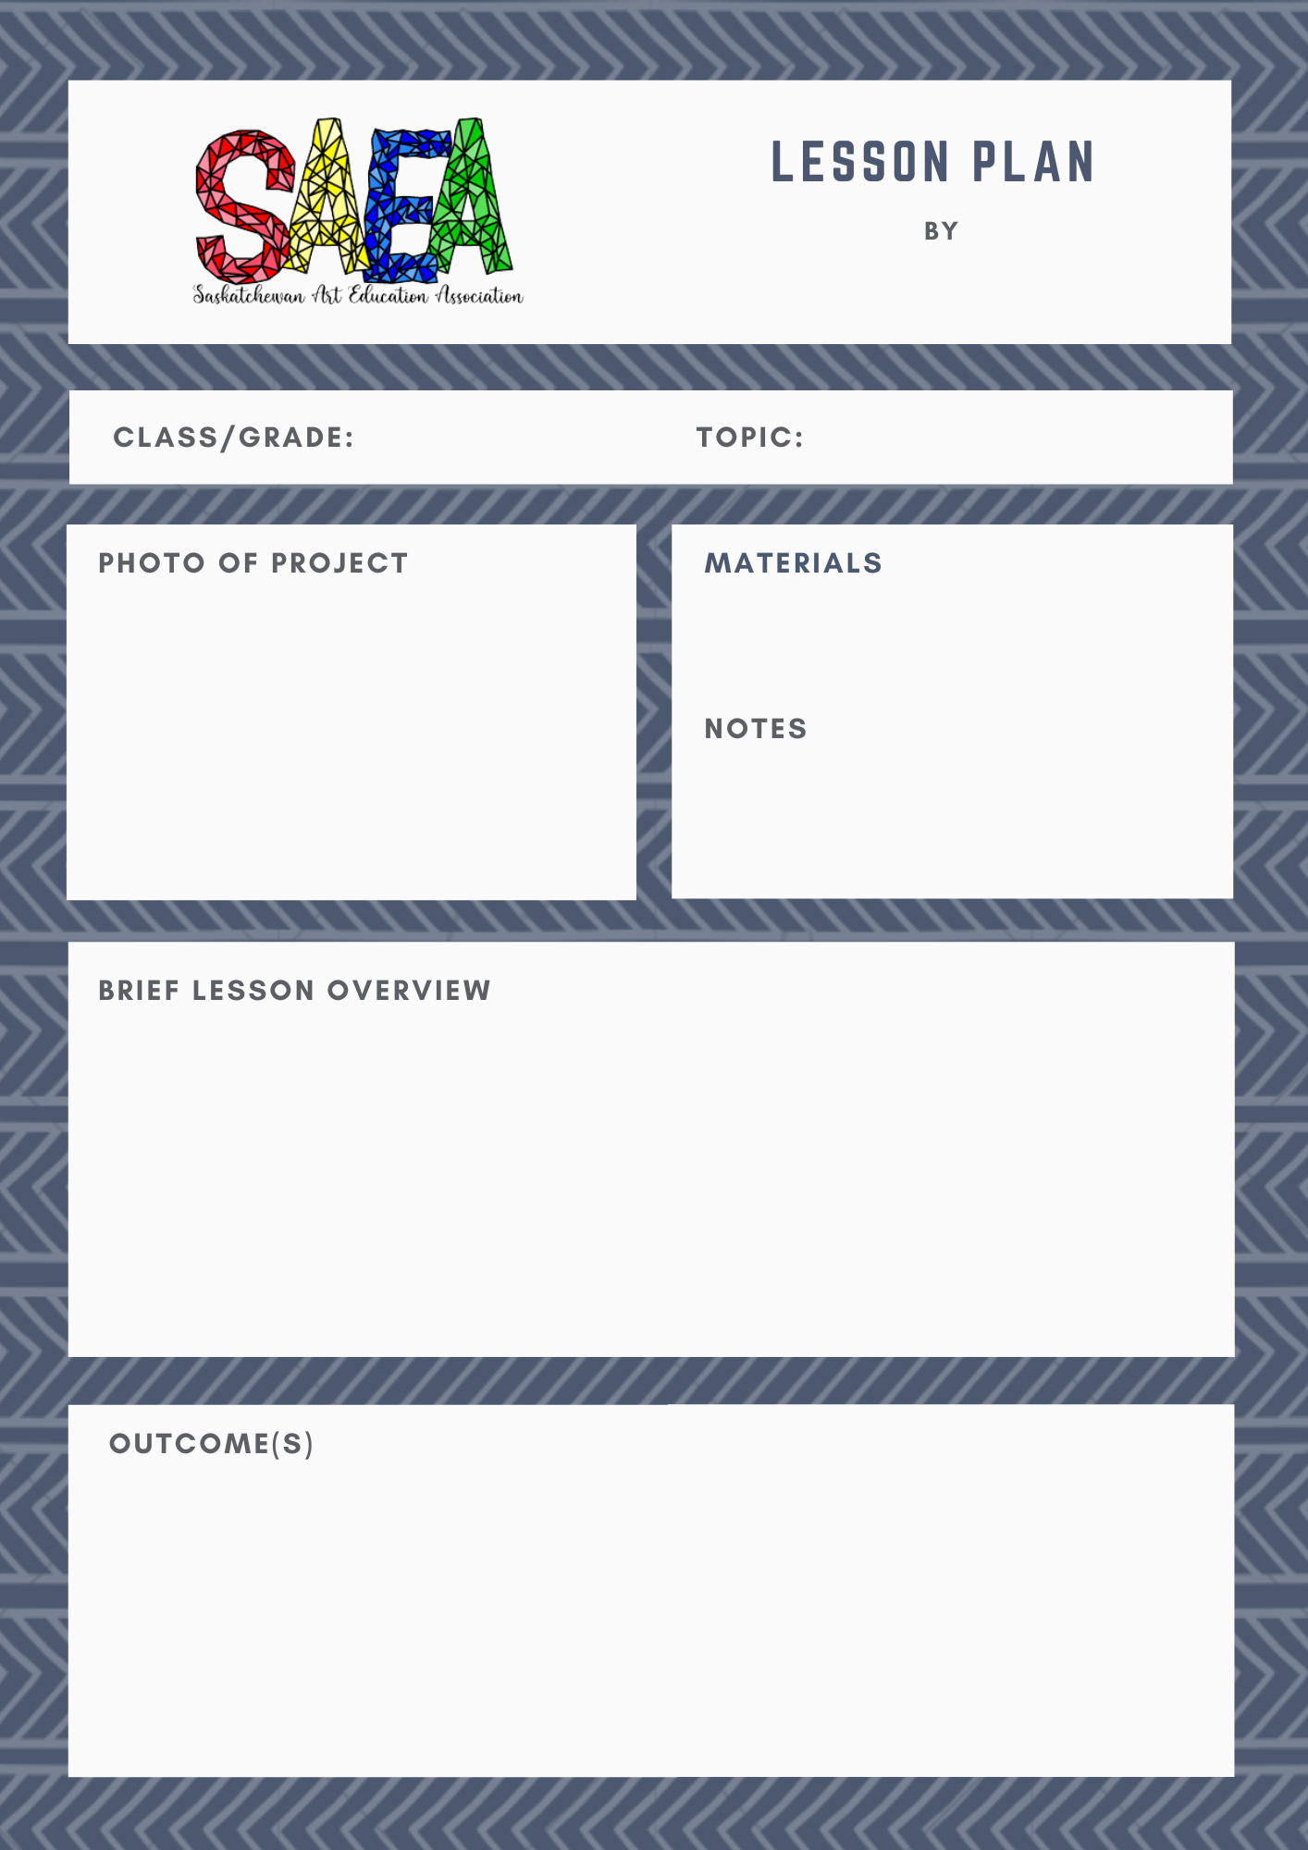
Insert your name here
Write class/grade here
Write topic name here
Insert an original photograph of the finished project here so teachers have an idea of the end product - this will also be the photo used to represent your lesson on the SAEA website. Delete this comment.
Include a list of materials here (then delete this comment)
Add any additional notes here (delete comment afterwards)
Provide a brief lesson overview here. Where possible, embed youtube/website links in the description so teachers can just click on those links from the overview. Then delete this comment.
Write your outcomes that the assignment meets here (and delete this comment)

Slide 2

1. Using brief, clear, explanations and original images, explain step-by-step how to complete the lesson/assignment. Please use original photos without student names attached or credit photos obtained online with a “Retrieved from: URL site” underneath those photos to credit other people’s materials. The steps must be kept to this page only (no adding extra pages)
Include how to assess the assignment in the section below - feel free to use the 10 point grading scale to assess outcomes on previous page or delete that and add your own information (delete this comment)
10 POINT GRADING SCALE
Level # | 10 | 9 | 8 | 7 | 6-5 | 4-1 | Insuff. Evidence | Absent Evidence
Description | Excellent | Advanced Proficiency | Proficient | Approaching Proficiency | Basic Knowledge | Limited Understanding | Insufficient Evidence | NHI / Redo
Adjectives | - Flawless - Exceeds expectations - Mastery of skills/concepts - Above grade level | - Strong - Advanced - Exceeds expectations | - Good - Meets expectations - Complete understanding of skills/concepts | - Okay - Developing skills and understanding of concept - Successful in some areas but needs improvement in other areas | - Demonstrates moderate skills/understanding of concept - Inconsistent | - Partially grasps skill/concept - Limited and low quality | - Incomplete - Missing key components - Considerably below grade level | - Student has not submitted evidence of work and/or student has submitted plagiarized or copied work as their own

